Slide 1
The Effectiveness of Intervention in Calculus Propensity Score matching
Cassandra Parker
Clark Atlanta University

Slide 2
Objectives
Introduction
Problem
Data Sets
Exploratory Analysis
Hypothesis/Statistical Analyis
Match it
Results
Suggestions

Slide 3
What is the problem?
The Mathematics Association of America (MAA) has reported the national average of unsuccessful Calculus 1 students to be 25%. And the D,W, F rate for Calculus at Clark Atlanta is at 34% which is above the national average.
Intervention at Clark Atlanta University been implemented. Therefor

Slide 4
Introduction
The intervention at Clark Atlanta University began Spring 2018 with a course redesign using the adaptive learning; Assessment and LEarning in Knowledge Spaces (ALEKS). The goal of the effort was to improve students’ mastery and the use of mathematical concepts through course redesign, assessment, and implementation using ALEKS which will enhance student mastery of learning outcomes, retention, and persistence rates in the undergraduate STEM degree programs at CAU. The ALEKS course product used was “Prep for Calculus,” a course that is designed to help students to develop the prerequisite foundation needed to learn Calculus I. Calculus I students in the course were divided into two groups. One section of the course was exposed (treatment group) to the ‘intervention”, while the other students learned Calculus I with previous teaching methods (control group).

Slide 5
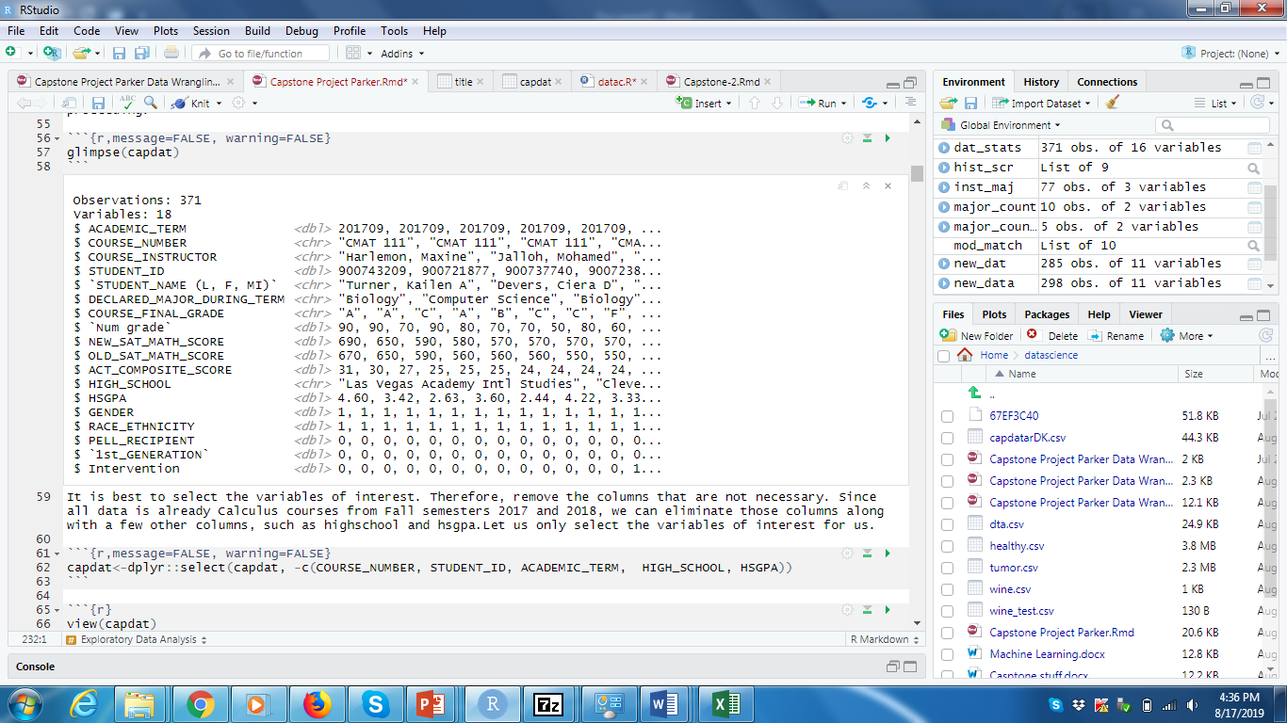
Data Set
Data wrangling is necessary to "clean up" data in order to analyze your information. Data set that was provided from Clark Atlanta has been cleaned. The techniques used were necessary in removing variables and changing names of columns, adding variables and few calculations.
The original data frame consisted of 371 Observations and 18 variable. There were some irrelevant information that was included in the original data frame that would not be necessary for propensity score matching algorithm. Removing these variables reduce the data frame to 15 variables, though there are some variable that could be still removed, keeping them would add to interesting data.
After doing more exploratory analysis, there were 11 variables since SAT and ACT score could not be utilized.

Slide 6
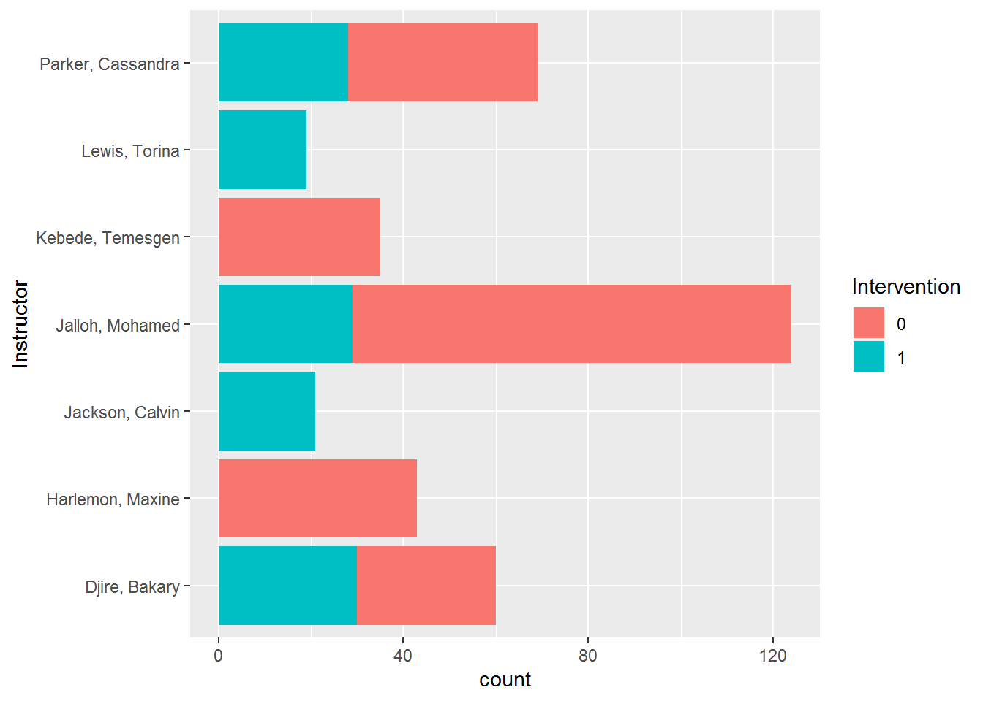
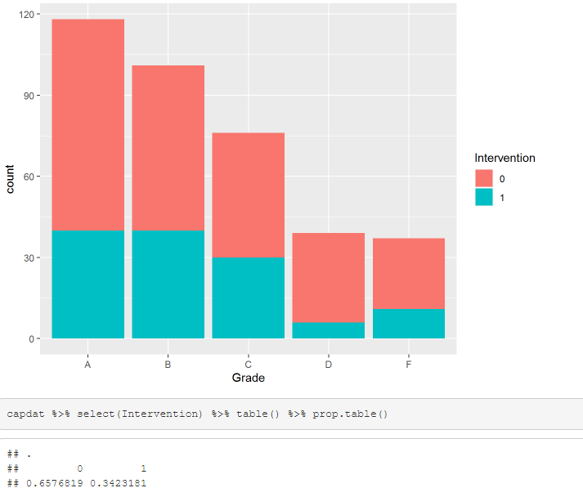
Exploratory Analysis
Figure 2
Our proportion tells us that 65% of the students did not have intervention (control group)and 34% did. Though the control group has a significant amount of students/observations, you can see the drastic decrease in the D and F grade categories. This is great defeat.
Figure 3. Here you can see an interesting fact the heavily student populated instructors have the mixture of students with intervention versus not. It is possible that students take certain professors in school year? Lets take one more look at grades, intervention, and instructor.

Slide 7
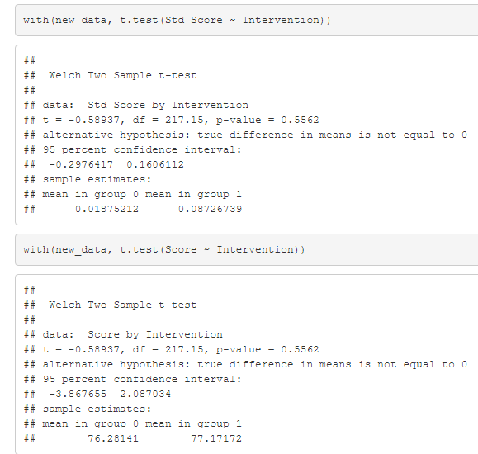
Statistical Analysis
There were a few statistical approaches done. The Welch t-test was completed to determine the p-value. A t test tells you how significant the differences between the score and std_score are.
*In simplest terms it will let us know if the measured averages of the groups could have happened by chance.
*If our data gives us low p-values such as p < 0.05 then, these are good values and indicate our data did not occur by chance.
Our results have a bit of a difference. I anticipated the p would be less than 0.05.Our p value is quite higher than from our raw data. Could the intervention grades just happen by chance? Perhaps we can do a variance test as well to double check.
Figure 4.

Slide 8
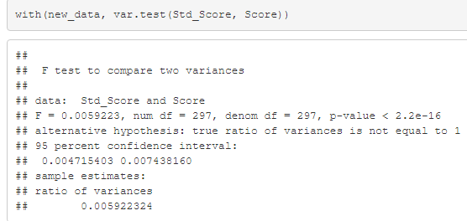
Variance Test
The variance looks good and there is a small interval. At this time we can move onto to the propensity portion using MatchIt. Guiding thru MatchIt, there was tons of information that makes this the perfect package to utilize.
Figure 5

Slide 9
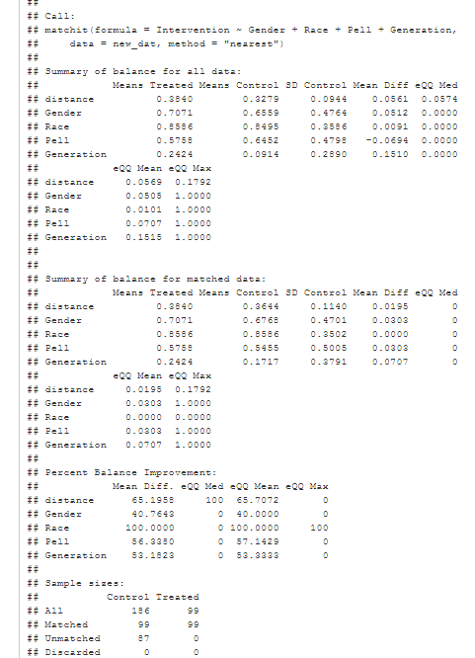
Match It
MatchIt implements the suggestions for improving parametric statistical models and reducing model dependence. When matching select duplicate observations from our data, hence this must be done without inducing bias and the is no dependency on the outcome variable.

Slide 10
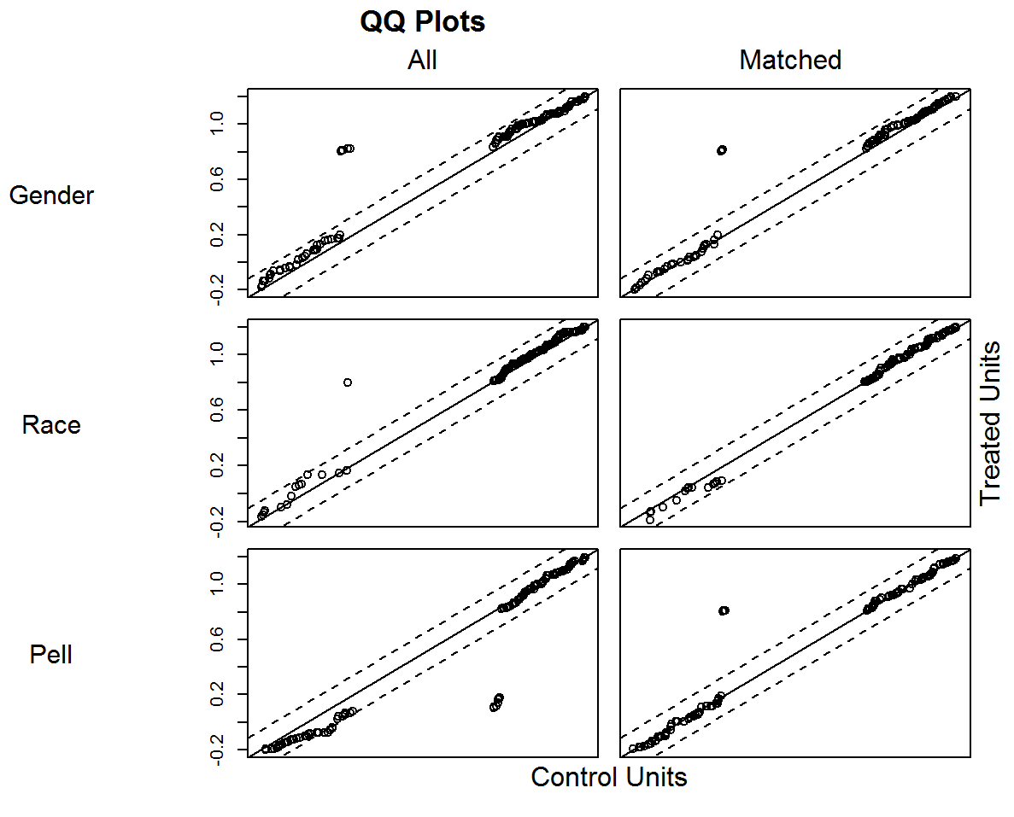
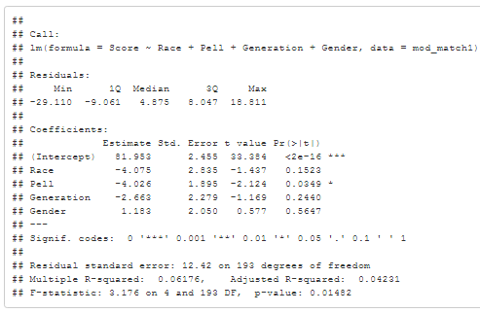
Figure 8.
Machine Learning . Testing the hypothesis
Figure 7.
Plots from the propensity score matching
This is the machine learning model.
y=82.550x1−5.44(race)−3.807(Pell)−2.267(Generation)+1.431(Gender)

Slide 11
Conclusion
The propensity score matching was to predict if the control group performed better in Calculus.
After the 198 observations (99 control vs 99 treated) were matched to “Pell”, “Race”, “Generation”, and “Gender” only based on their Mathematical Score, there was some “significance”, but not enough to hold any statistical value.
Looking at our R Squared we did not get to near 1% as expected. The Residual standard Error is quite high as well.
As we can see our p-value in terms of “Pell” and “Race” is 2%. Meaning students are NOT by chance making better grades in the course. This could possibly mean that the intervention maybe be EFFECTIVE. I believe our data is too small for us to get the conclusion we are looking for.

Slide 12
Recommendations
Collect data on students utilizing other variable such as SAT, Study time, or some possible variable that influences their grade.
Look at the data Fall versus Spring Semesters, as it has been hypothesized that student typically do better in the Fall.
Look at other Interventions methods. Perhaps having a co-requiste calculus course as apposed to relying on student to complete on their own.

Slide 13
Future Work
What would happen if the data set was larger? What would happen if influencers of grades were added as variables, such as the Study time, tutoring, SAT scores? Does certain instructors make a difference? These would be all things I would collect data for and work on future work for this particular study. In my instructor role I would look at prediction of final grades based on some of the same variables including class time and strictly only online course.

